Slide 1

Al Dubai
Fragrances
Strategy Analysis
~by Ahiri Mukherjee

Slide 2
Strategy Analysis for Luxury Fragrance Brand
CONTENTS:-
Introduction
Marketing Team Analytics in Excel
HR Analytics in SQL
Conclusion

Slide 3
Introduction
Al Dubai Fragrances is a privately held luxury goods retailer and distributor, headquartered in Dubai, UAE. Al Dubai Group is the largest retail operator in the Middle East. It played a crucial role in developing the luxury sector in the region. The company has more than 12,000 employees, in 14 countries.
Al Dubai operates in two major modes, one is through its mobile application and the second is through its various offline stores that they have across Dubai and the middle east. Under the brand name Al Dubai Fragrances, they have a wide variety of products for both Males and Females but their major distribution is across fashion products and accessories among female customers.

Slide 4
Marketing Team Analytics using Excel

Slide 5
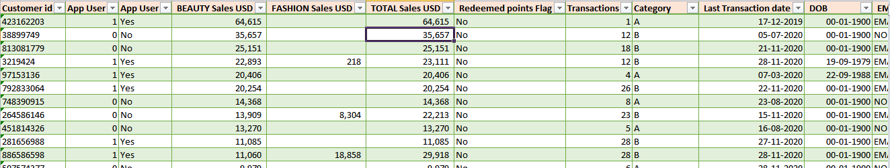
A short overview of the given data.

Slide 6
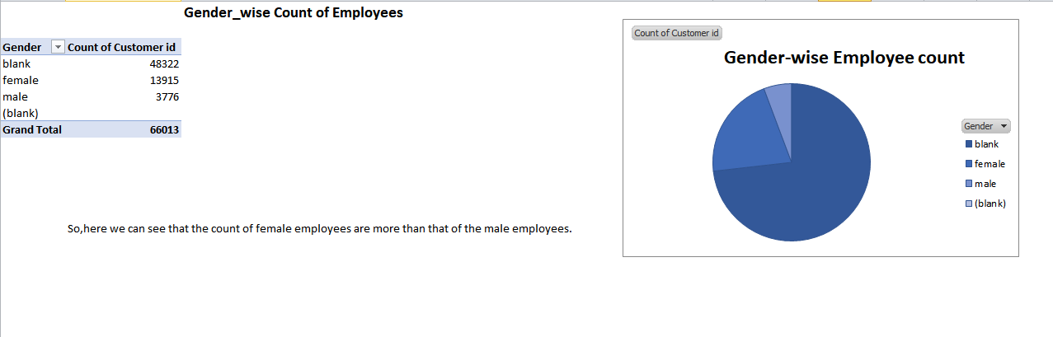
Gender-wise count of Employees

Slide 7
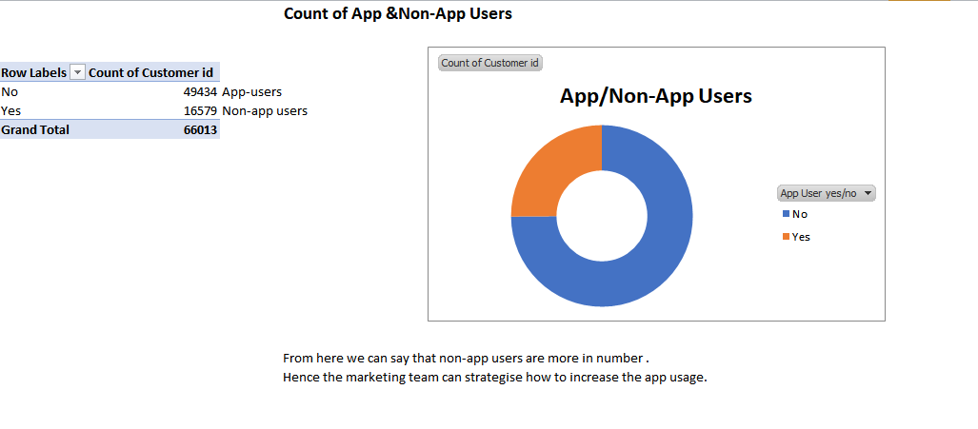
App & Non-App Users

Slide 8
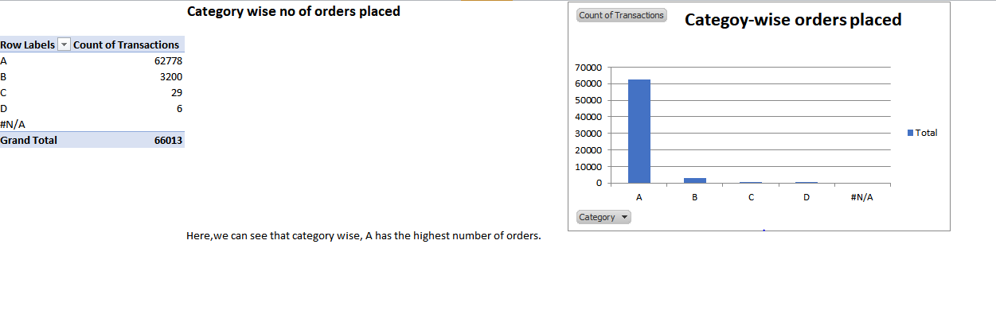
Category-wise Orders Placed

Slide 9
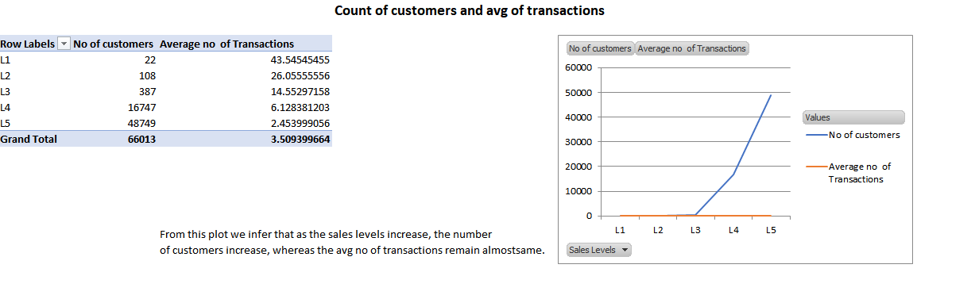
Count of customers and average of transactions

Slide 10
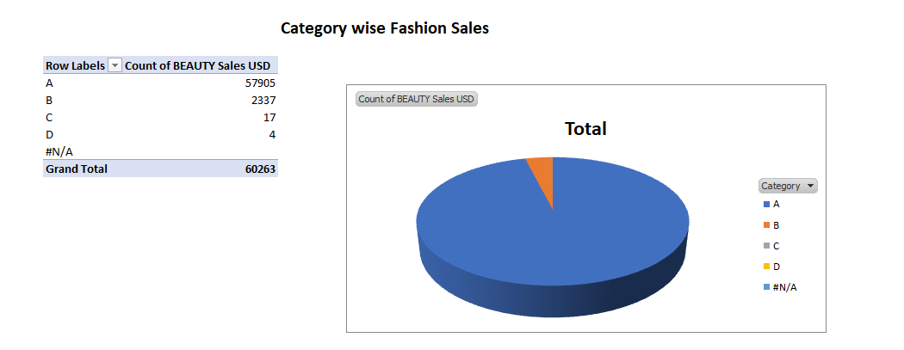
Category wise Fashion sales

Slide 11
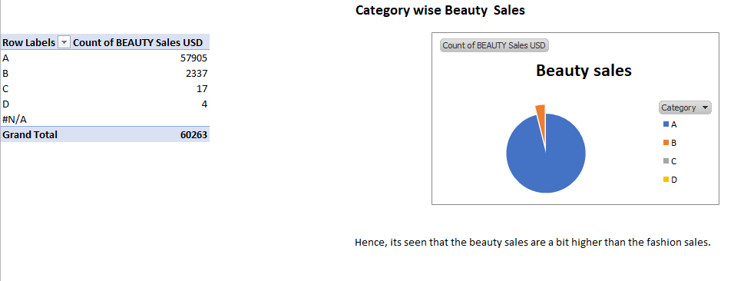
Category wise Beauty Sales

Slide 12
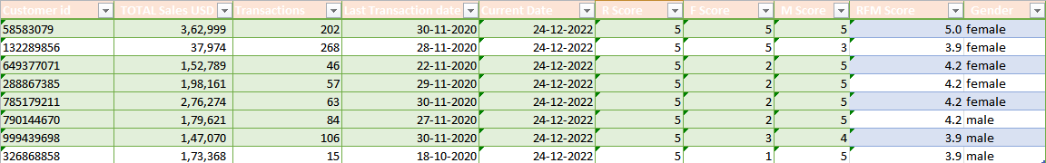
Top Performing Customers
Analysing the RFM Score of the customers, based on their sales, transactions, etc; I have found these customers to be the top performing ones.

Slide 13
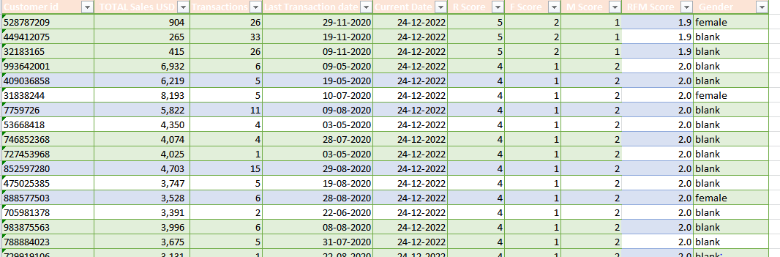
Worst Performing Customers
Analysing the RFM Score of the customers, based on their sales, transactions, etc; I have found these customers to be the worst performing ones.

Slide 14
HR Team analytics using SQL Queries

Slide 15
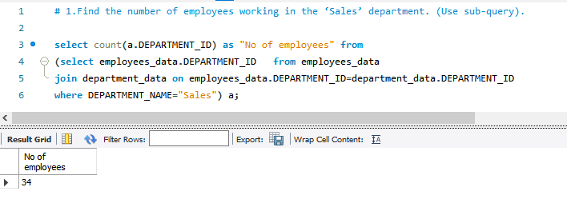
Number of employees working in the SALES Department:-

Slide 16
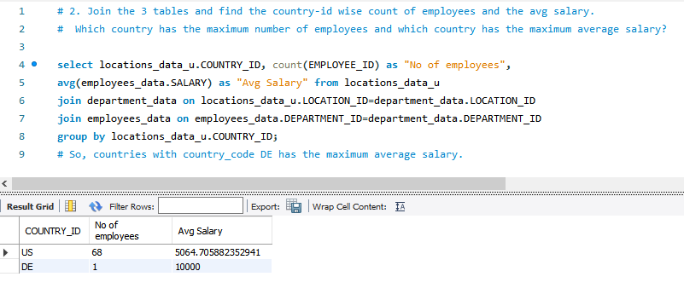
Country-wise Employee Count and Average Salary:-

Slide 17
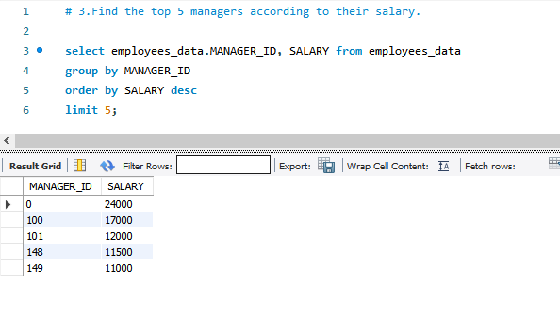
Top 5 managers according to salary:-

Slide 18
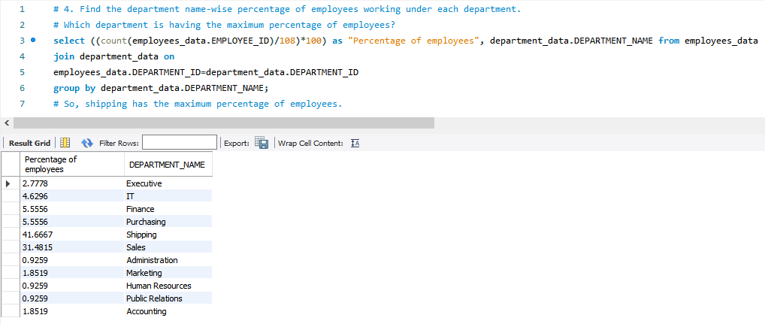
Department wise percentage of employees:-

Slide 19
CONCLUSION
The insights drawn from the various charts, pivot tables , SQL queries will help the the marketing team of AL Dubai Fragrances to strategize in order to increase their sell by targetting the right customers , supposedly from the top performing ones.
Similarly, the insights drawn for the HR team will help them to understand the problem and improve their team in order for the company to perform better.

Slide 20


